Slide 1
multilevel parking system
Team: Money=Power
Frank, Kaiyu
2014.4.7

Slide 2
Problem Statement
Our university doesn’t have enough parking space in some places in the campus, so many students and teachers are late for class because of looking for parking space. Therefore, we should change some parking areas into multilevel parking system. This system should able to park more cars than before in the same area and work under extremely cold temperatures.

Slide 3
Constraints
1. Lower than 5% of the MTU budget.(8 million dollars)
2. Parking more cars than before.
3. Protect the parking lot from the weather.

Slide 4
Criteria
1. Low cost
2. High efficiency for parking cars.
3. Safety
4. Durable
5. Good appearance

Slide 5
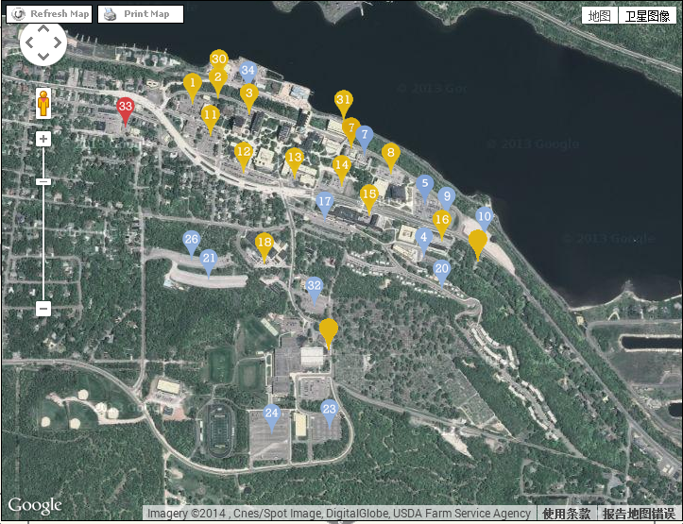
Campus Map

Slide 6
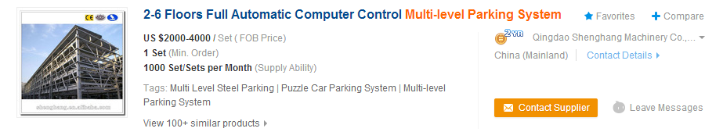
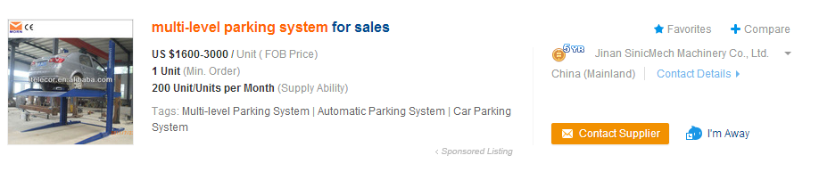
Research
http://www.alibaba.com/showroom/multi--level-parking-system.html

Slide 7
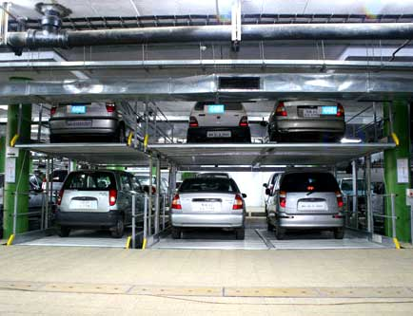
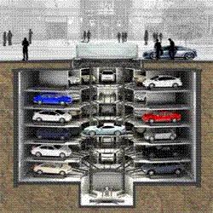
Example
http://affordmotors.com/images/gallery/parkingyard/3.jpg
http://3.imimg.com/data3/FM/CS/MY-550639/intelligent-parking-system-250x250.gif

Slide 8
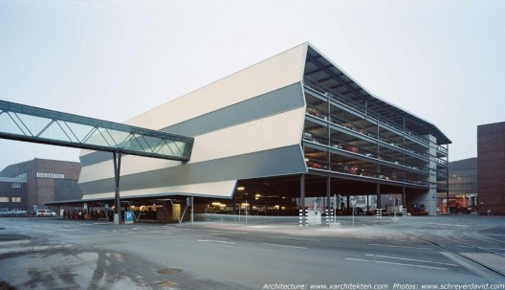
Another Example
http://ad009cdnb.archdaily.net/wp-content/uploads/2009/12/1260541745-081209i-01-3500-kopie-528x303.jpg

Slide 9
Question time

